Slide 1
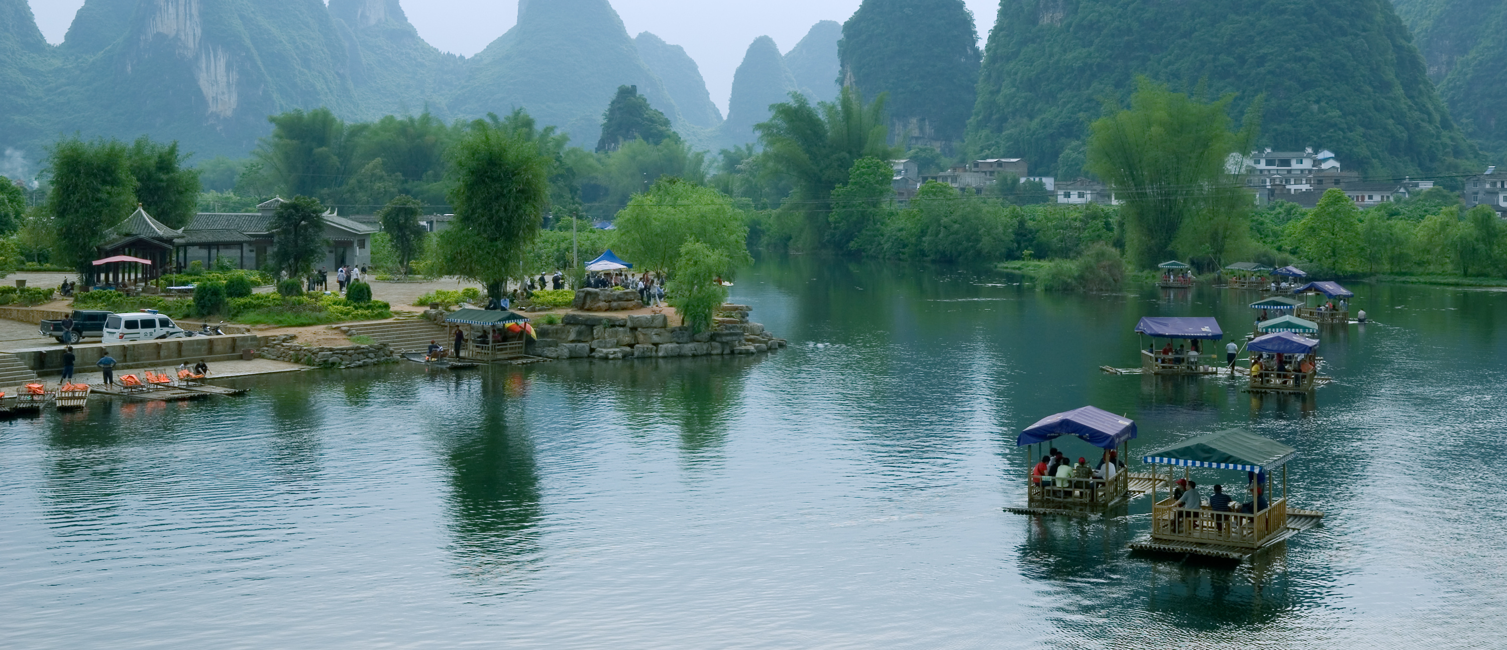
CHINA
F. BOLLON
FRMB-CONSULTING
March 2020

Slide 2
GEOGRAPHY REMINDER

Slide 3
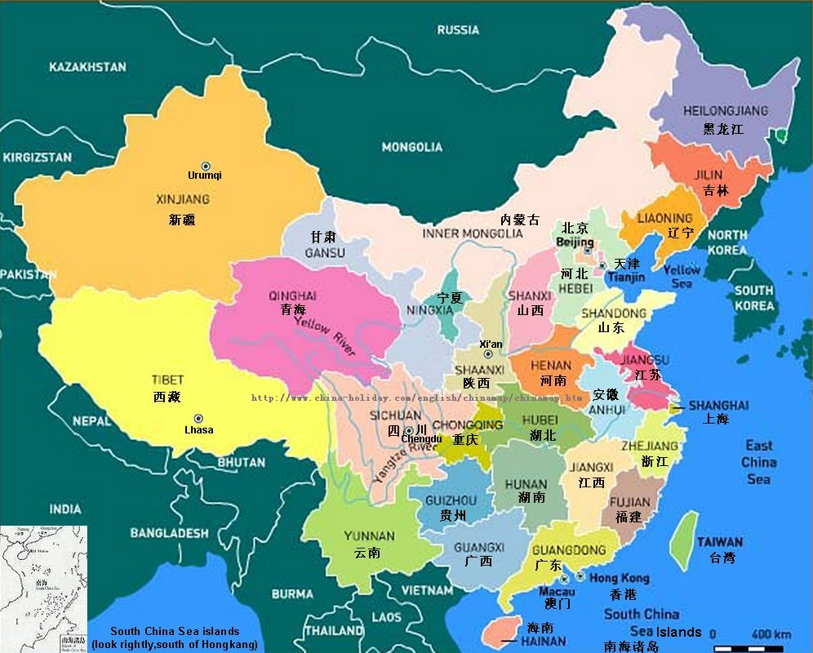
Surface area 17.3 x FRANCE
5,200 km
5,000 km

Slide 4
CHINA - FRANCE
Characteristics | China | France
Surface area (km²) | 9,561,000 | 552,000
Population | 1,368 M | 66 M
Density of population (inhab./km²) | 143 | 120
Arable lands (%) | 11.3 | 33.4
Median age | 35.5 years | 40.8 years
Birth rate (per thousand) | 12.1 | 12.4
Mortality rate (per thousand) | 7.2 | 8.2

Slide 5
POLITICAL ENVIRONMENT

Slide 6
CHINA Key points of the political environment
China is a People's Republic led by the Chinese Communist Party (CCP) since 1949.
Since 1993, the General Secretary of CPC is also the President of the Republic.
Since 1997 and the death of Deng Xiaoping, senior Party leaders could not do more than two terms of five years and age limits are imposed on staff and leader of the Party. the policy renewal at the top of the Party used to occur every ten years
But since 2017, the limitation of the number of terms for the Chinese president has been abolished. President Xi Jinping can become President for life

Slide 7
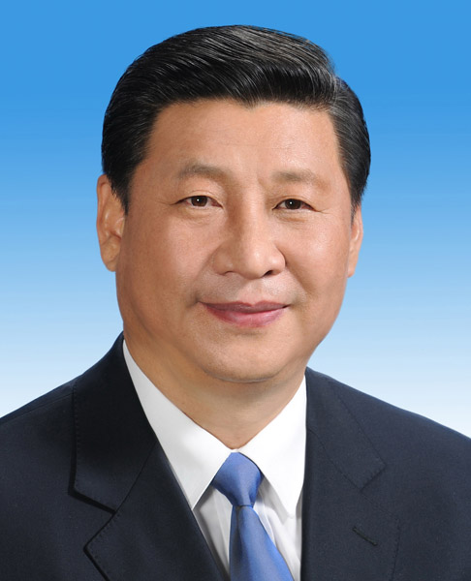
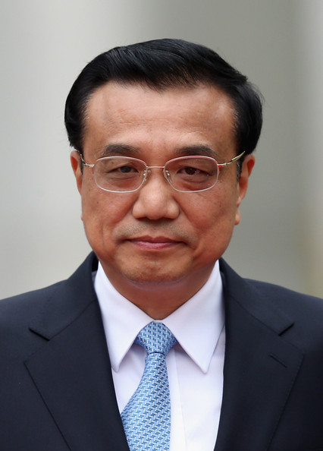
CHINA Key points of the political environment
Party Secretary XI Jinping (习近平) Born in 1953, Shaanxi
Prime Minister Li Keqiang (李克强) Born in 1955, Anhui
The other five members of the Politburo Standing Committee are: Li Zhanshu (Chairman of the standing committee of the National people’s Congress), Wang Yang (Chairman of the Chinese People's Political Consultative Conference), Wang Huning (Chinese political theorist), Zhao Leji (anti-corruption fight responsible) and Han Zhen (first vice premier of the state council)
Previous positions: Vice-President (2008-2013), governor of Fujian (1999-2002), secretary of the Zhejiang Party (2002-2007)
Previous positions: Deputy Prime Minister (2008-2013), secretary of the Liaoning Party (2004-2007) and Henan (2002-2004), First Secretary of the League of Communist Youth (1993-1998)

Slide 8
GEOPOLITICAL ISSUES

Slide 9
CHINA GEOPOLITICAL ISSUES
China is facing many geopolitical issues notably:
The South China sea
The Chinese support to North Korea
The African presence of China
The presence of China in Siberia
The Climate Change Conferences

Slide 10
CHINA GEOPOLITICAL ISSUES
China is facing many geopolitical issues notably:
The leadership of the world in front of the USA
The political evolution of Hong Kong and Taiwan
The Belt and Road Initiative
The relationship with Europe and USA following the Made in China 2025 program
The Corona Virus Covid-19

Slide 11
THE BELT AND ROAD INITIATIVE
Launched in 2013, the Belt and Road Initiative, formerly known as One Belt, One Road, is essentially a slogan but it could eventually cover all the Chinese commercial diplomacy.
The basic concept consists of the construction of infrastructure (ports, railways, roads, etc.), loans, investment programs, a development bank and the creation of special economic zones in China.
89% of the BRI contracts have so far been awarded to Chinese companies. It appears that the Chinese State collects and distributes public and private funds to finance and ensure the international development of its domestic enterprises.

Slide 12
THE BELT AND ROAD INITIATIVE
Its total cost (up to USD 1,000 billion) and the number of countries involved (at least 60) vary depending on the source.
The Chinese slogan "一带一路"[yīdài yīlù] is commonly translated as "a belt, a road". But "带" also means "what is around" China.
Thus, in the strict sense, the "road" is the overland route of about 10,000 km linking Europe and China, and the "belt" would be the maritime route linking these two continents via the Indian Ocean, the Suez Canal and the Mediterranean.
All the infrastructure aimed at building these 2 roads would be financeable by the project.

Slide 13
THE BELT AND ROAD INITIATIVE
In a broader sense, the "belt" could encompass all regions of the world:
Africa
South America
Antarctica with a "Polar Silk Road"...
and even the World as a whole, with the idea of a digital silk road.

Slide 14
MADE IN CHINA 2025
Program Made in China 2025
Accelerate the automation of factories and the integration of digital technology into the core of the production system through a series of loans or tax incentives with nearly 40 billion euros injected between 2016 and 2020.
Target declared in terms of market share of Chinese industry on the domestic market (e. g. 50% domestic market share for industrial robots by 2020, 70% by 2025).

Slide 15
MADE IN CHINA 2025
Priority sectors
New energy vehicles and equipment.
Information technology.
Advanced industrial and robotic machines.
Marine engineering and high-tech shipbuilding.
Advanced railway equipment.
Power generation (power plants, networks and equipment).
New materials.

Slide 16
MADE IN CHINA 2025
With the China 2025 program China wants to increase the competence of its companies and move from the world's workshop to a kind of global incubator of new technologies.
Faced with the rising cost of Chinese labour, the impending labour shortage and the desire to move upmarket, Chinese companies are looking to locate where they can manufacture their products at lower costs.
China is also seeking to reduce its transport and logistics costs by locating as close as possible to its markets and to protect its exports by establishing a presence along all the shipping lines it has to use. (cf. the Chinese military base in Djibouti)

Slide 17
CHINA AND AFRICA

Slide 18
CHINA AND AFRICA History of the relationship
China's presence in Africa is very old.
The presence of black slaves in China is cited as early as the 8th century...
Admiral Zheng He is said to have crossed the Indian Ocean at the head of a fleet of more than 200 ships to sail along the coast of East Africa and trade with natives of Tanzania, Kenya and Somalia between 1417 and 1433.
But the Chinese left little trace of their passage in Africa in the face of the numerous Portuguese trading posts that settled from the 15th century and the Arab, Pakistani and Indian immigrants who arrived from the 19th century onwards.
A number of Chinese communities can be found from 1860 onwards in Madagascar, Mauritius and Reunion Island; it is also from this period that Chinese coolies were “imported” for railway construction or for work in the mines.

Slide 19
CHINA AND AFRICA History of the relationship
It was the advent of the People's Republic of China in 1949 that revived China's interest in Africa with essentially political ties: Third World solidarity against the Western powers with an acceleration following the Bandung Conference in 1955.
Several Afro-Asian conferences followed: Cairo (1957), Accra (1958), Conakry (1960), Mogadishu (1963), Winneba (1965) with Ghana, Guinea and Mali as the main countries in relation with China.
Zhou En Lai's visit in 1964 to 10 African countries: Egypt, Morocco, Algeria, Sudan, Guinea, Ghana, Mali, Ethiopia, Somalia and Tunisia was marked by Sino-African solidarity.
The construction of the Tanzam railway linking Tanzania to Zambia completed in 1976 with the help of 50,000 Chinese is the most emblematic investment of the Chinese presence in Africa during this period.

Slide 20
CHINA AND AFRICA Economic exchanges
For the past 20 years, economic concerns have dominated relations between China and Africa.
The economic takes precedence over the ideological, even though the People's Republic of China has taken advantage of this to gradually eliminate Taiwan's presence in Africa. Taiwan maintains relations in Africa with only 4 countries: Burkina Faso, Sao Tome and Principe, Gambia and Swaziland.
The increase in trade is quite spectacular, rising from less than 1 billion dollars in 1977 to 10 in 2000, 37 in 2005 and more than US$190 billion in recent years.
6 countries account for 2/3 of this trade through their energy and mining resources and domestic consumption: South Africa, Angola, Nigeria, Sudan, Egypt and Algeria.

Slide 21
CHINA AND AFRICA Minerals
Angola is ahead of South Africa as China's largest African trading partner, mainly due to oil.
With regard to mineral products, China is interested in:
Guinea bauxite
Copper from Zambia
Copper from the Democratic Republic of Congo
The iron of Sierra Leone
Namibia's lead and zinc
Etc

Slide 22
CHINA AND AFRICA Agriculture and forestry
But China is also interested in the products of agriculture and forestry in Africa.
China is developing many rice development projects
It also is increasing cotton imports from West Africa even though China is the world's largest cotton producer.
In fact, China imports African cotton and transforms it into yarns and fabrics that it sends back to Africa for the manufacture of garments produced in Africa by Chinese companies and exported to the USA and Europe.
China is also looking for arable land in the DRC, Mozambique, Tanzania, Uganda, Zimbabwe and Cameroon, where Sino Cam Inko is located on nearly 10,000 hectares.

Slide 23
CHINA AND AFRICA Agriculture and forestry
China has obtained important timber concessions in Congo and Cameroon.
It is considered that 75% of the wood exported from Africa goes to China.
The Shengyang company bought the French company Gabon Export Bois in 2010. Similarly, Plysorol Europe based in Lisieux and its Gabonese subsidiaries were bought by Guohua Zhang, a Chinese businessman.
Much of Africa's forests are illegally logged to export timber to China. But the main scandal of this illegal logging is the trade in precious and protected species, such as kevazingo from Gabon or rosewood from Madagascar..
Between 2000 and 2013, nearly 9 million hectares of African forest disappeared.

Slide 24
CHINA AND AFRICA Major projects
Buildings, public works and industrial equipment are the most visible elements of the Chinese presence in Africa.
More than half of the tenders in these areas are won by Chinese companies.
An example: China Road and Bridge Corporation, based in Nairobi, has 22 branches on the Continent.
Chinese construction sites are present in almost all African countries: coastal motorway in Algeria, the Sports Palace in Yaoundé, most of the official buildings on Boulevard Omar Bongo in Libreville, the Gibe III dam in Ethiopia, the new African Union headquarters in Addis Ababa, etc.

Slide 25
CHINA AND AFRICA The Chinese presence in Africa
China also has a significant financial presence
China has thus become the leading donor in Sudan, Nigeria, Angola, Egypt through the Exim Bank, the ICBC (Industrial and Commercial Bank of China) and more recently through the Asian Infrastructure Investment Bank (AIIB), which groups 57 countries and wants to be an alternative to the World Bank.
For several years now, China has been flooding Africa with its products at very competitive prices: bicycles, crockery, toys, trinkets, tools, buses, trucks, etc., sometimes competing with certain local products.

Slide 26
CHINA AND AFRICA The Chinese presence in Africa
It is estimated that there are 10,000 Chinese companies in Africa, 90% of which are described as "private".
Nearly 1 million Chinese live in Africa.
1/3 of these companies are in production, 1/4 in services, 1/5 in trade, construction and real estate.
In the manufacturing sector, it is estimated that 12% of Africa's industrial production is managed by Chinese companies, or about $500 billion a year.
Over the past 20 years, trade growth has been growing at 20% per year and Chinese foreign direct investment in Africa at 40% per year.
Trade is currently about $190 billion and is expected to reach $250 billion by 2025.

Slide 27
CHINA AND AFRICA The Chinese presence in Africa
Trade with Africa of various countries compared to China

Slide 28
CHINA AND AFRICA An example of the Chinese presence
In Dukem, 40 km from Addis Ababa, a Chinese-run industrial park where the world's largest shoe company is located.
"The entrance to the industrial park is guarded by Chinese in black uniforms. On an area of 40 hectares, Chinese companies have been able to set up factories of all kinds. Among them a huge shoe workshop where, behind thousands of sewing machines, young Ethiopian women are supervised by female Chinese foremen.
The manufacturer Huajian has signed manufacturing contracts with Guess and Calvin Klein brands. Its business plan foresees an export stream from Ethiopia that should bring it $4 billion over 10 years.

Slide 29
CHINA AND AFRICA An example of the Chinese presence
In the prefabricated buildings that serve as the reception hall of the industrial park, the director, Jiao Yongshun, explains that these facilities have been paid for by the companies but that it is a free zone: no taxes for eight to ten years, customs services on the spot and a one-stop shop for the Ethiopian administration, proximity to Djibouti so that finished products can then be shipped around the world.
Chinese companies are thus closer to their customers by paying their African workers much less than Chinese employees, whose hourly wage has tripled over the past decade. And Ethiopia is seeing tens of thousands of its people rise out of unemployment or poverty. “ (Le Journal du Dimanche - January 4, 2018).

Slide 30
CHINA AND AFRICA An example of the Chinese presence
There are half a dozen parks, like the one in Dukem, in Ethiopia. The largest of them, in Awassa, built by the China Communications Construction Company on 130 hectares for $250 million, includes some 15 textile factories.
There are almost as many in neighbouring Tanzania

Slide 31
THANK YOU VERY MUCH FOR YOUR ATTENTION
F. BOLLON
FRMB-Consulting – frmbollon@yahoo.com

